Slide 1
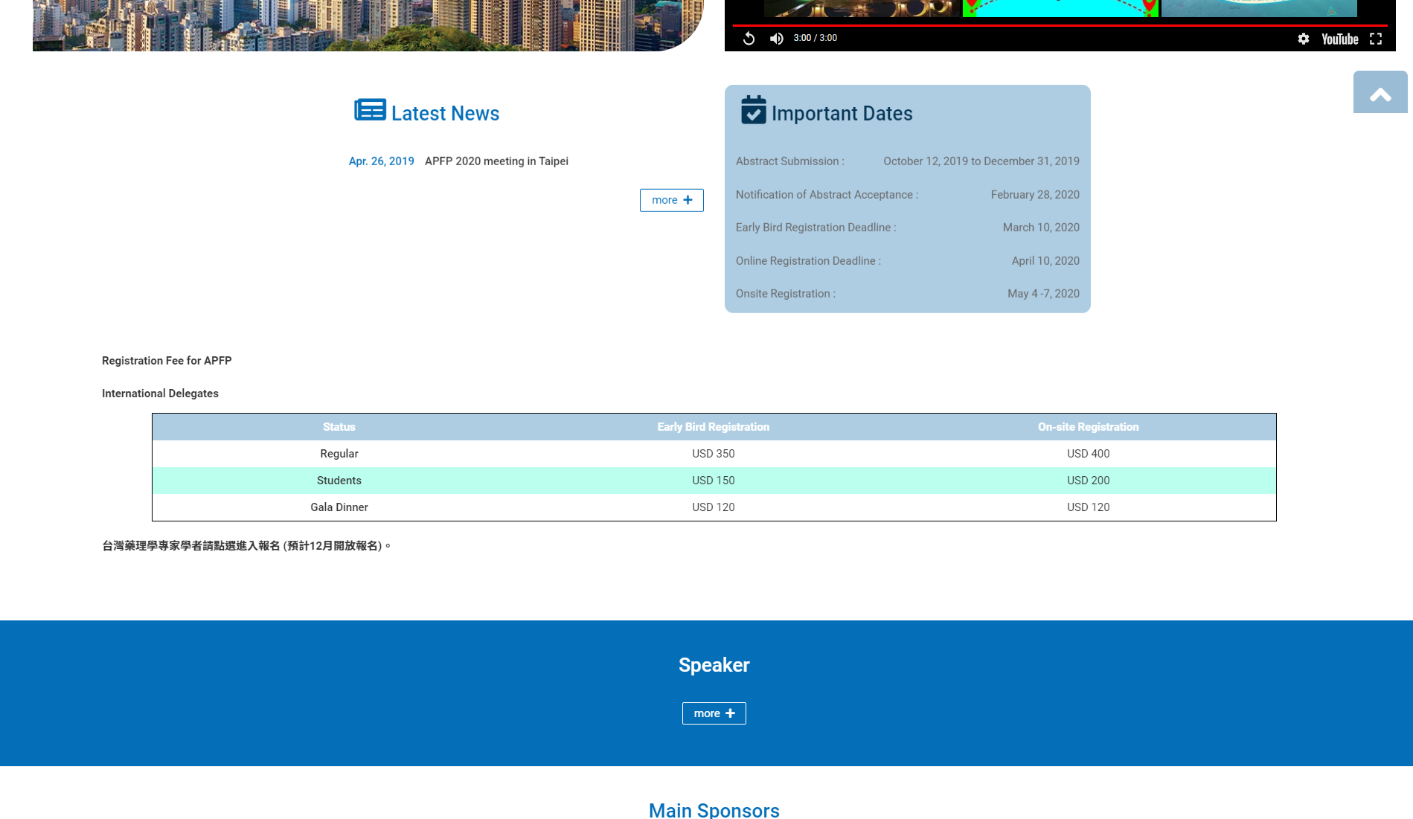
插入紅字於後方
≃NTD 11,000
≃NTD 13,000
≃NTD 4,600
≃NTD 6,500
≃NTD 3,700
≃NTD 4,000
下方插入此表格
Status | Early Bird Registration | On-site Registration
Regular(Taiwan) | NTD 2,500 | NTD 3,000
Students(Taiwan) | NTD 1,000 | NTD 1,500
Gala Dinner(Taiwan) | NTD 1,500

